Slide 1
Unit - 6 Memory Organization

Slide 2
Topics Covered
Memory Hierarchy,
Main Memory,
Auxiliary Memory,
Associative Memory,
Cache Memory,
Virtual Memory

Slide 3
Memory Hierarchy

Slide 4
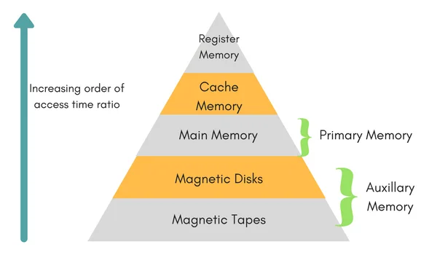
Memory Hierarchy
In the Computer System Design, Memory Hierarchy is an enhancement to organize the memory such that it can minimize the access time.
Below is the diagram that shows different types of memories used in computer system.

Slide 5
Memory Hierarchy
This Memory Hierarchy Design is divided into 2 main types:
External Memory (Secondary Memory)
Internal Memory (Primary Memory)

Slide 6
Memory Hierarchy
External Memory (Primary Memory) - Comprising of Magnetic Disk, Optical Disk, Magnetic Tape i.e. peripheral storage devices which are accessible by the processor via I/O Module

Slide 7
Memory Hierarchy
Internal Memory or Primary Memory – Comprising of Main Memory, Cache Memory & CPU registers. This is directly accessible by the processor.

Slide 8
Memory Hierarchy
We can observe that as we go from top level to bottom
Read/Write speed decrease
Cost per byte decrease
Access time increase
Capacity Increase

Slide 9
Main Memory (RAM & ROM)

Slide 10
Read-Only Memory (ROM)
A read-only memory (ROM) is essentially a memory device in which permanent binary information is stored.
The binary information is generally specified by the manufacturer and is then embedded in the computer system.
A ROM which can be re programmed is called a PROM. The process of entering information in a ROM is known as programming.
ROMs are used to store information i.e. firmware, BIOS etc.

Slide 11
Random access memory (RAM)
Used in computers for the temporary storage of programs and data.
Read and write both operations are performed by RAM which requires fast cycle times as not to slow down the computer operation.
It is volatile and lose all stored information if power is interrupted or turned off.
RAM chip typically come with word capacities of 1K, 4K, 8K, 16K, etc.. and word sizes of 1, 4 or 8-bits.
It can be expanded by combining several memory chips.

Slide 12
Random access memory (RAM)
Static RAM | Dynamic RAM
1. SRAM has lower access time, so it is faster compared to DRAM. | 1. DRAM has higher access time, so it is slower than SRAM.
2. SRAM is costlier than DRAM. | 2. DRAM costs less compared to SRAM.
3. SRAM requires constant power supply, which means this type of memory consumes more power. | 3. DRAM offers reduced power consumption, due to the fact that the information is stored in the capacitor.
4. Due to complex internal circuitry, less storage capacity is available compared to the same physical size of DRAM memory chip. | 4. Due to the small internal circuitry in the one-bit memory cell of DRAM, the large storage capacity is available.
5. SRAM has low packaging density. | 5. DRAM has high packaging density.
6. No need to refresh periodically. | 6. Due to capacitor used as storage element, information may lose over period of time. So, need to refresh periodically.

Slide 13
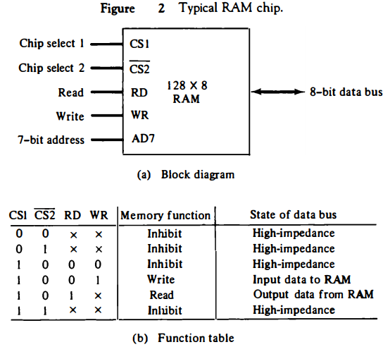
Block Diagram of RAM

Slide 14
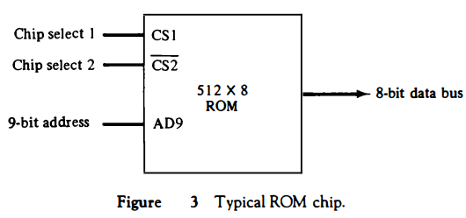
Block Diagram of ROM

Slide 15
Memory Address Map

Slide 16
Memory Address Map
The designer of a computer system must calculate the amount of memory required for the particular application and assign it to either RAM or ROM.
The interconnection between memory and processor is then established from knowledge of the size of memory needed and the type of RAM and ROM chips available.
The addressing of memory can be established by means of a table that specifies the memory address assigned to each chip.
The table, called a memory address map, is a pictorial representation of assigned address space for each chip in the system.

Slide 17
Memory Address Map
To demonstrate with a particular example, assume that a computer system needs 512 bytes of RAM and 512 bytes of ROM.

Slide 18
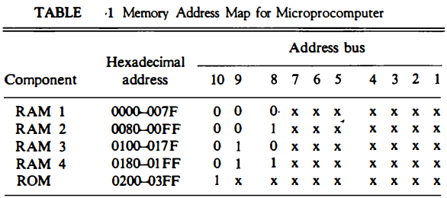
The memory address map for this configuration

Slide 19
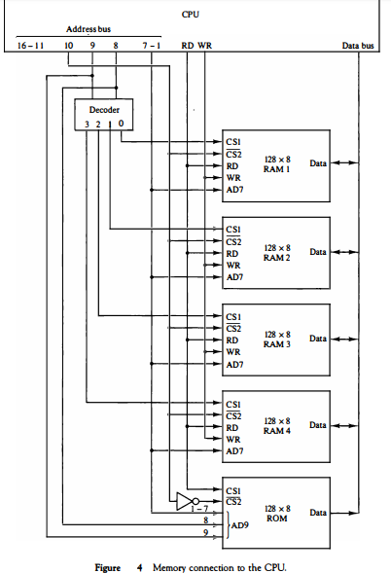

Slide 20
Auxiliary Memory

Slide 21
Auxiliary Memory
An Auxiliary memory is referred to as the lowest-cost, highest-space, and slowest-approach storage in a computer system.
It is where programs and information are preserved for long-term storage or when not in direct use.
The most typical auxiliary memory devices used in computer systems are magnetic disks, optical disk and tapes etc.

Slide 22
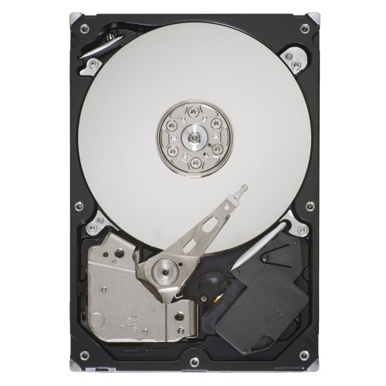
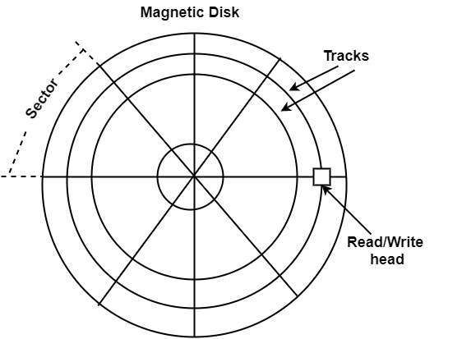
Magnetic Disks

Slide 23
Magnetic Disks
A magnetic disk is a round plate generated of metal or plastic coated with magnetized material.
There are both sides of the disk are used and multiple disks can be stacked on one spindle with read/write heads accessible on each surface.

Slide 24
Magnetic Disks
All disks revolve together at high speed and are not stopped or initiated for access purposes.
Generally disk revolve at speed of 5200 RPM or 7200 RPM
Read and Write operation is performed using Read/Write Head
Bits are saved in the magnetized surface in marks along concentric circles known as tracks.

Slide 25
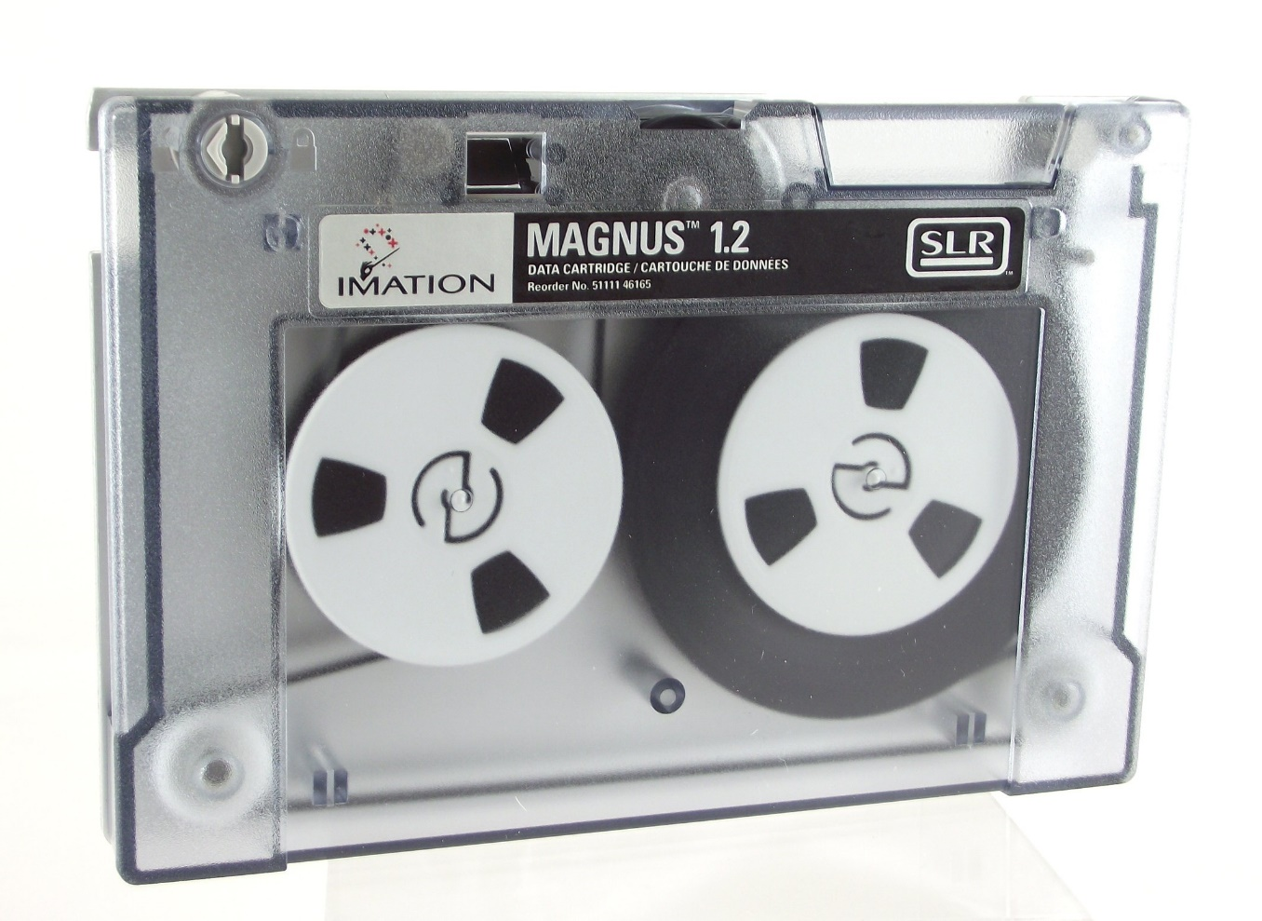
Magnetic Tape
The tape is a layer of plastic coated with a magnetic documentation medium where bits can be stored.
Bits are listed as a magnetic stain on the tape along various tracks.

Slide 26
Magnetic Tape
Magnetic tape units can be stopped, initiated to move forward, or in the opposite, or it can be reversed.
Speed of tape can not be changed to perform faster data read/write.

Slide 27
Associative Memory

Slide 28
Associative Memory
In most cases, data in any memory is accessed using its location (address).
On other hand,
An associative memory can be treated as a memory unit whose saved information can be accessed/searched by the content of the information itself instead of by an address or memory location.

Slide 29
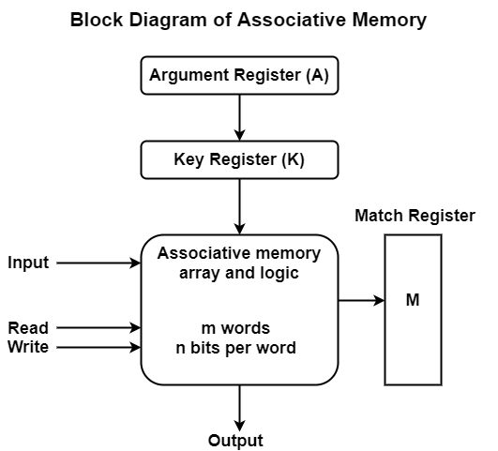
Associative Memory
Block diagram of associative memory is shown here.
It includes a memory array and logic for m words with n bits per word.
The argument register A and key register K each have n bits, one for each bit of a word.

Slide 30
Associative Memory
The match register M has m bits, one for each memory word. Each word in memory is related in parallel with the content of the argument register.

Slide 31
Associative Memory
The words that connect the bits of the argument register set an equivalent bit in the match register.
After the matching process, those bits in the match register that have been set denote the fact that their equivalent words have been found.

Slide 32
Associative Memory
Searching is done in parallel way for all the location simultaneously.
After searching Reading is done in sequential access to memory for those words whose equivalent bits in the match register have been set.

Slide 33
Associative Memory
The key register supports a mask for selecting a specific field or key in the argument word.
The whole argument is distinguished with each memory word if the key register includes all 1’s.
Hence, there are only those bits in the argument that have 1's in their equivalent position of the key register are compared.

Slide 34
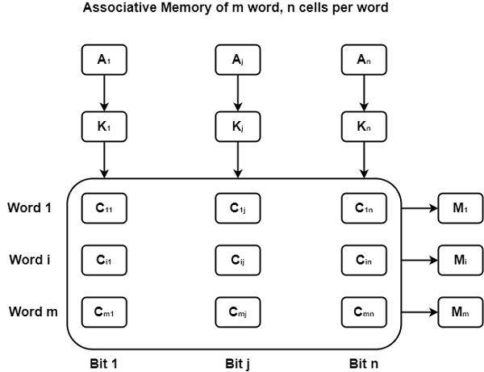
Associative Memory

Slide 35
Cache Memory

Slide 36
Cache Memory
Speed of Primary memory is slower compared to the processing power of CPU.
To improve the performance of CPU processing cache memory is used as a buffer between CPU and Primary memory.
Cache is way more faster compare to primary memory and also it is cheaper to CPU registers. So cache is used as a buffer between CPU and primary memory to increase the performance of CPU.

Slide 37
Cache Memory
What Cache memory contains?
The data or contents of the main memory that are used frequently by CPU are stored in the cache memory so that the processor can easily access that data in a shorter time.
Whenever the CPU needs to access memory, it first checks the cache memory. If the data is not found in cache memory, then the CPU moves into the main memory.

Slide 38
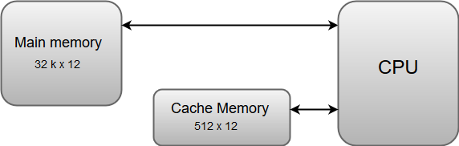
Cache Memory

Slide 39
Cache Memory
The basic operation of a cache memory is as follows:
When the CPU needs to access memory, the cache is examined. If the word is found in the cache, it is read from the fast memory.
If the word addressed by the CPU is not found in the cache, the main memory is accessed to read the word.
A block of words one just accessed is then transferred from main memory to cache memory. The block size may vary from one word (the one just accessed) to about 16 words adjacent to the one just accessed.
The performance of the cache memory is frequently measured in terms of a quantity called hit ratio.
When the CPU refers to memory and finds the word in cache, it is said to produce a hit.
If the word is not found in the cache, it is in main memory and it counts as a miss.
The ratio of the number of hits divided by the total CPU references to memory (hits plus misses) is the hit ratio.

Slide 40
Cache Mapping

Slide 41
Cache Mapping
Cache mapping defines how a block from the main memory is mapped to the cache memory in case of a cache miss.
OR
Cache mapping is a technique by which the contents of main memory are brought into the cache memory

Slide 42
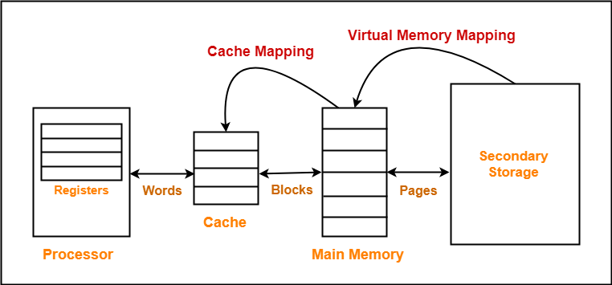
Cache Mapping

Slide 43
Cache Mapping
Important Note to remember:
Main memory is divided into equal size partitions called as blocks or frames.
Cache memory is divided into partitions having same size as that of blocks called as lines.

Slide 44
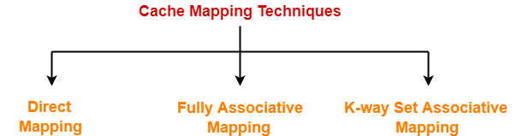
Cache Mapping Techniques

Slide 45
Direct Mapping
In direct mapping,
A particular block of main memory can map only to a particular line of the cache.
The line number of cache to which a particular block can map is given by-
Cache line number = ( Main Memory Block Address ) % (Number of lines in Cache)

Slide 46
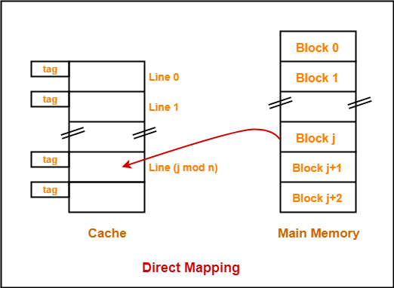
Direct Mapping
Consider cache memory is divided into ‘n’ number of lines.
Then, block ‘j’ of main memory can map to line number (j mod n) only of the cache.

Slide 47
Direct Mapping
Need of Replacement Algorithm
There is no need of any replacement algorithm.
This is because a main memory block can map only to a particular line of the cache.
Thus, the new incoming block will always replace the existing block (if any) in that particular line.

Slide 48
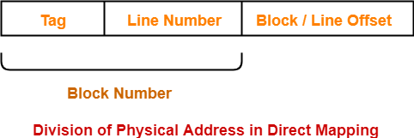
Direct Mapping
Division of Physical Address

Slide 49
Fully Associative Mapping
In fully associative mapping,
A block of main memory can map to any line of the cache that is freely available at that moment.
This makes fully associative mapping more flexible than direct mapping

Slide 50
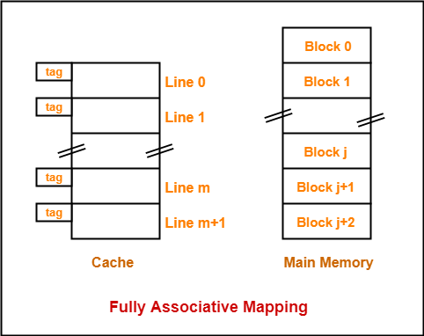
Fully Associative Mapping
Example
All the lines of cache are freely available.
Thus, any block of main memory can map to any line of the cache.
Had all the cache lines been occupied, then one of the existing blocks will have to be replaced.

Slide 51
Fully Associative Mapping
Need of Replacement Algorithm
A replacement algorithm is required.
Replacement algorithm suggests the block to be replaced if all the cache lines are occupied.
Thus, replacement algorithm like FIFO, Round Robin etc. algorithms are used.

Slide 52

Fully Associative Mapping
Division of Physical Address

Slide 53
Set Associative Mapping
In set associative mapping,
Cache lines are grouped into sets where each set contains k number of lines.
A particular block of main memory can map to only one particular set of the cache.
However, within that set, the memory block can map any cache line that is freely available.
The set of the cache to which a particular block of the main memory can map is given by-
Cache set number = ( Main Memory Block Address ) % (Number of sets in Cache)

Slide 54
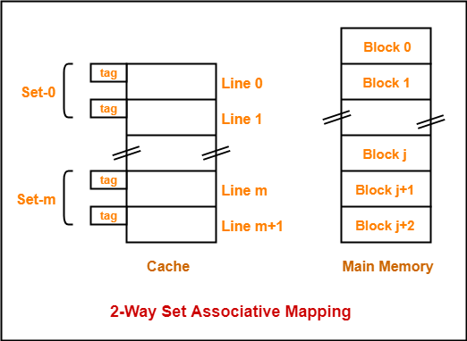
Set Associative Mapping
Example
Here k = 2 suggests that each set contains two cache lines.
Since cache contains 6 lines, so number of sets in the cache = 6 / 2 = 3 sets.
Block ‘j’ of main memory can map to set number (j mod 3) only of the cache.
Within that set, block ‘j’ can map to any cache line that is freely available at that moment.
If all the cache lines are occupied, then one of the existing blocks will have to be replaced.

Slide 55

Set Associative Mapping
Division of Physical Address

Slide 56
Virtual Memory

Slide 57
Virtual Memory
Virtual Memory is a storage scheme that provides user an illusion of having a very big main memory. This is done by treating a part of secondary memory as the main memory.
Virtual memory is a valuable concept in computer architecture that allows you to run large, sophisticated programs on a computer even if it has a relatively small amount of RAM
Instead of loading one big process in the main memory, the Operating System loads the different parts of more than one process in the main memory.

Slide 58
Virtual Memory
A computer with virtual memory artfully juggles the conflicting demands of multiple programs within a fixed amount of physical memory.
A PC with small amount of RAM can run more program which can be beyond the capacity of RAM by using the virtual memory. (Program will generally run slower)

Slide 59
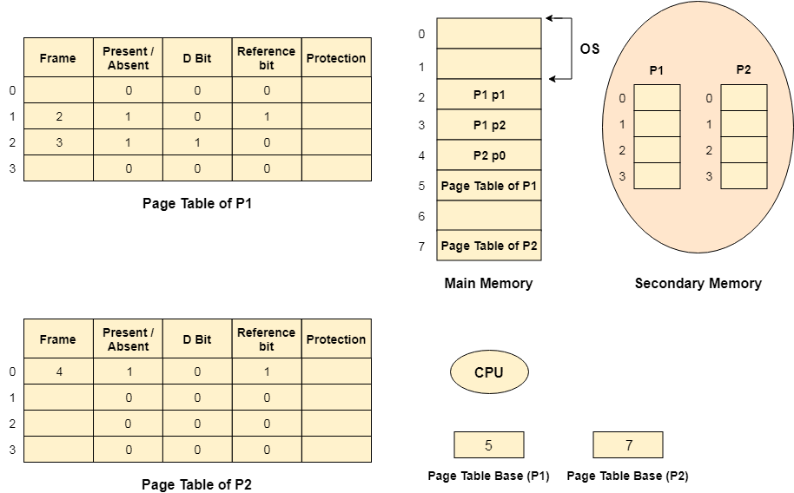
Virtual Memory

